Slide 1
Disney+ Hotstar Analysis
Presented by: Vignesh Gowda

Slide 2
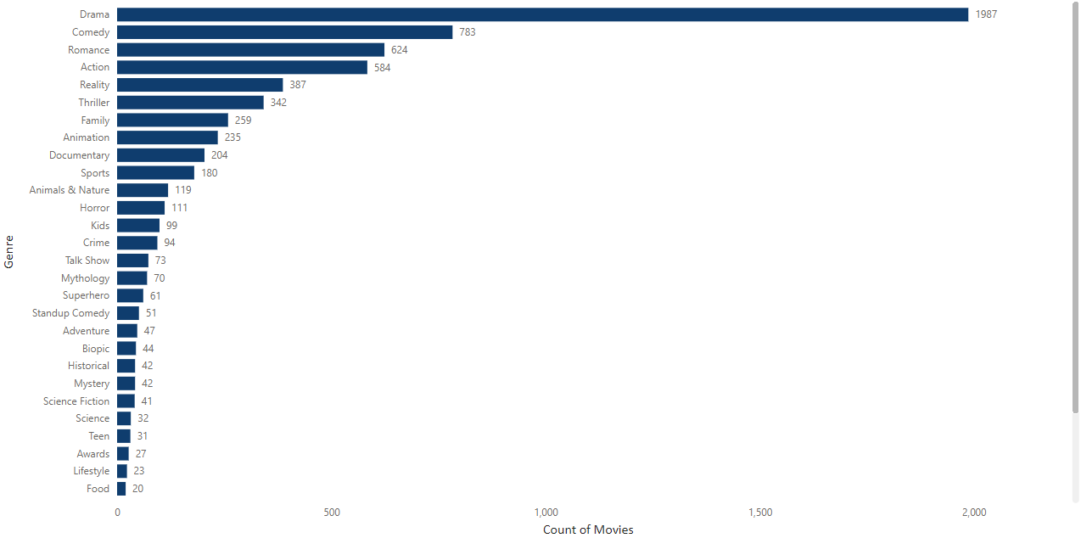
Movies by Genre
Summary:
Drama genre has the highest number of titles with 1987 accounting to 29.75
The least number titles is under Docudrama with 5 movies

Slide 3
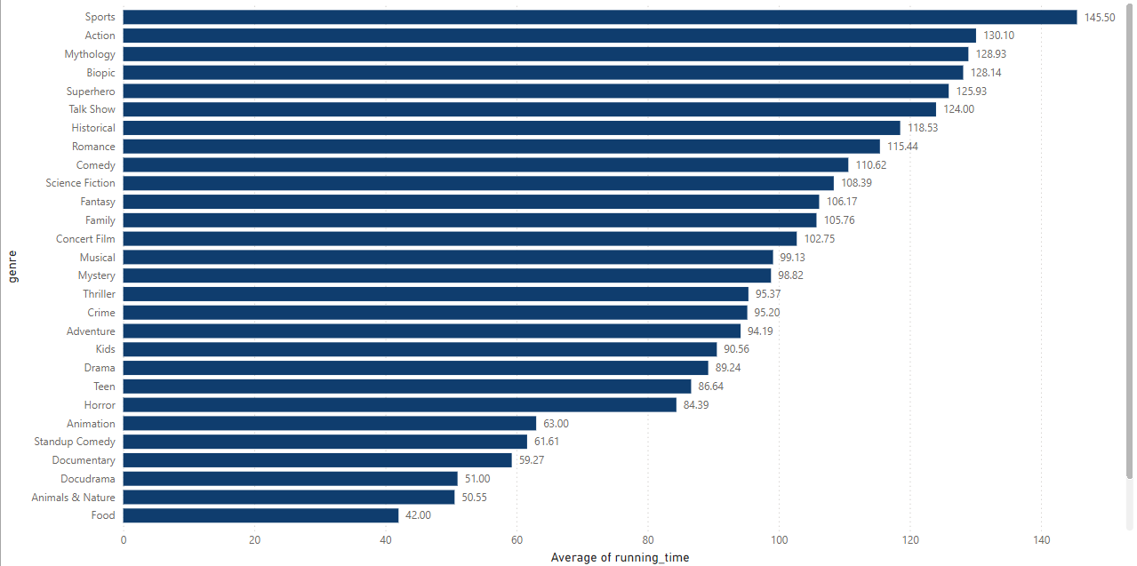
Avg runtime by genre
Summary:
Sports genre had the highest avg runtime with an avg of 145.5 mins
Shorts had the lowest avg time with 6.75 mins

Slide 4
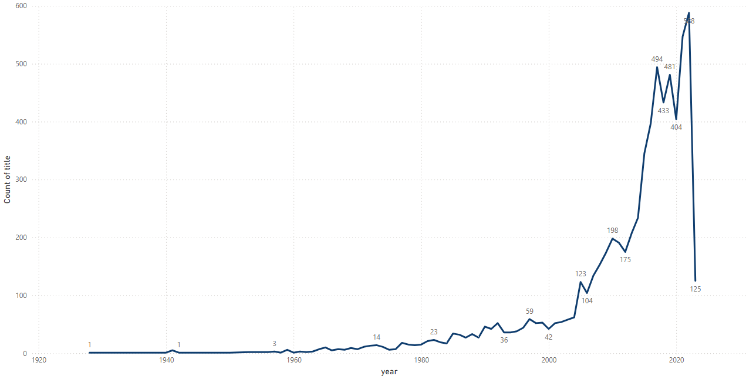
Movie released each year
Summary:
Year 2022 had the highest releases with 588
Year 1928 had one release which is the lowest

Slide 5
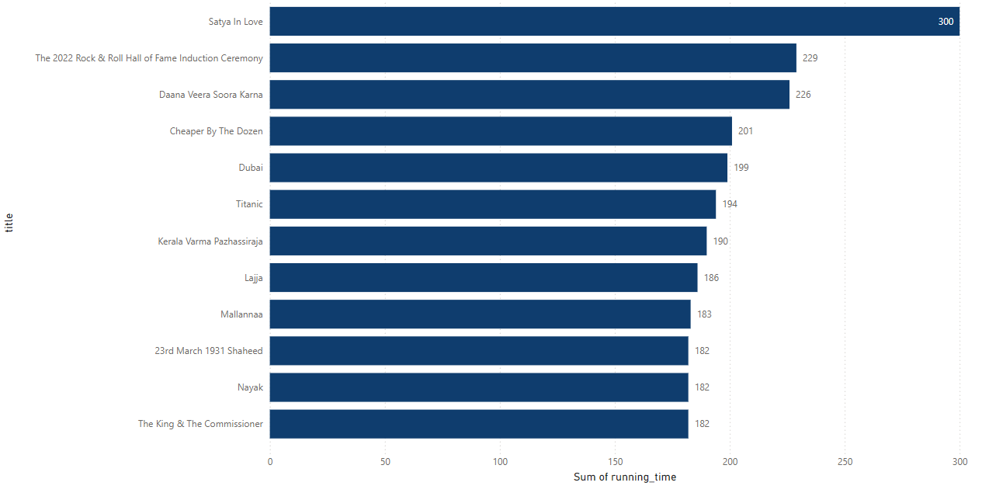
Longest Movie
Summary:
Top 10 movies with the longest runtimes listed above

Slide 6
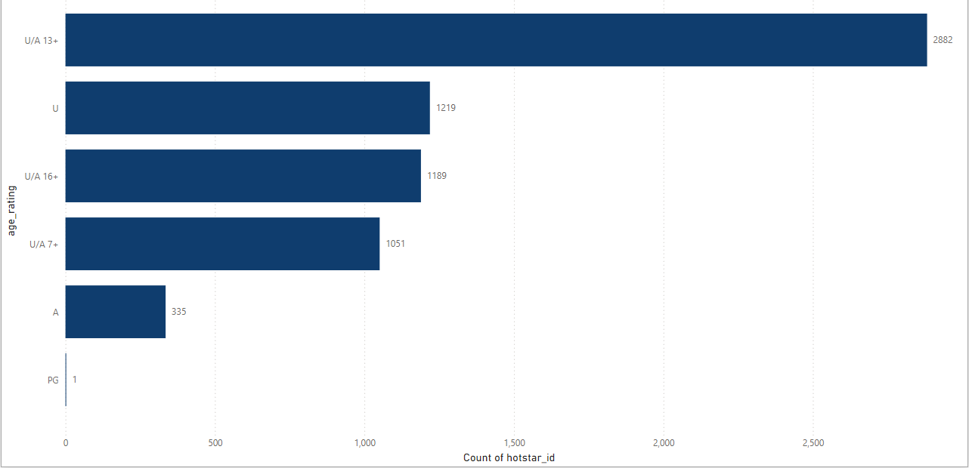
Age Rating
Summary:
43.13 (2882) titles were given a rating of U/A 13+
18.25 titles were rated ‘U’ & 17.80 titles were rated U/A 16+

Slide 7
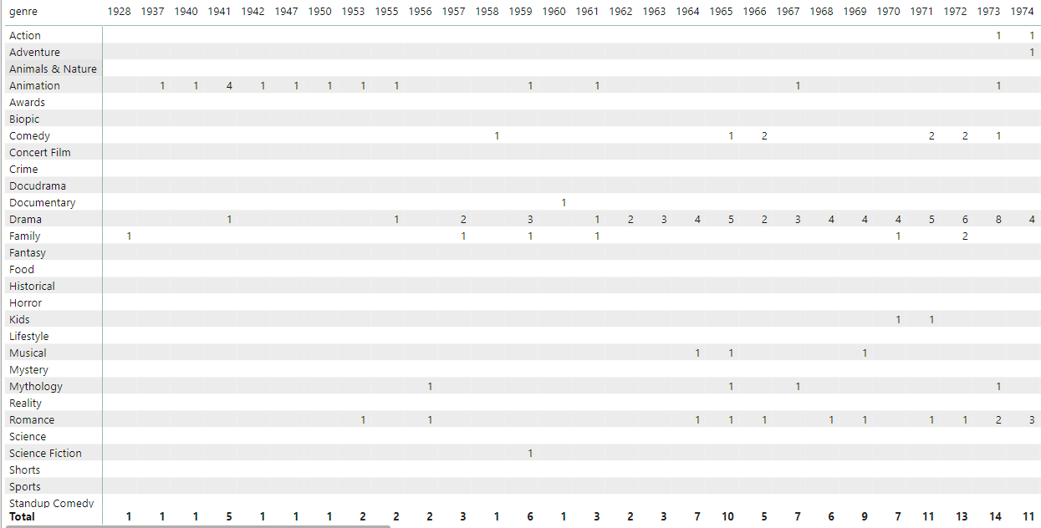
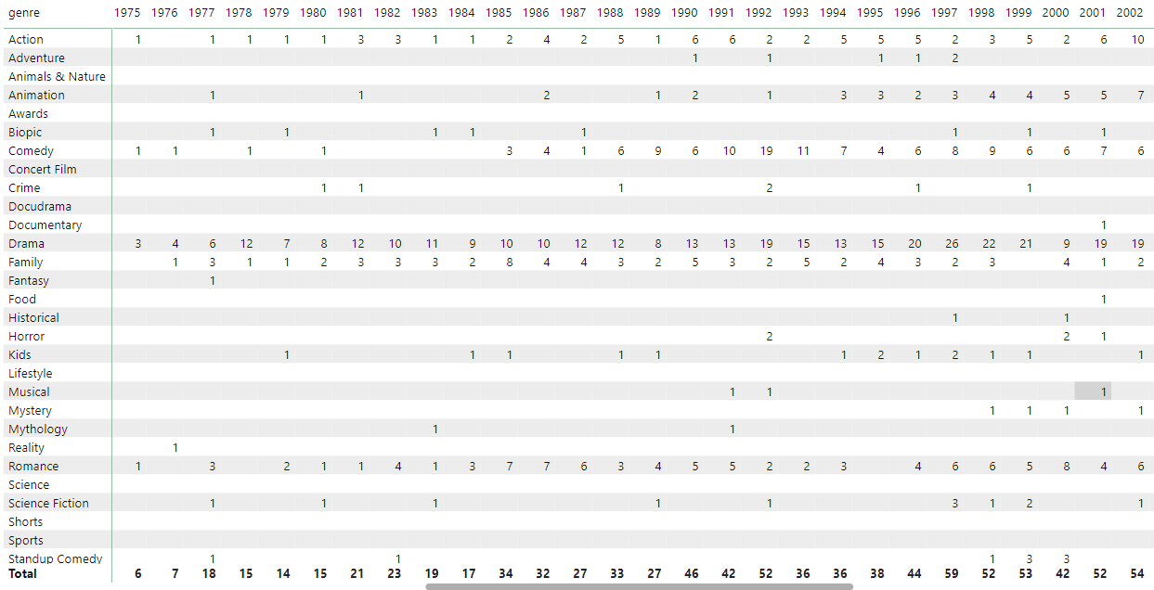
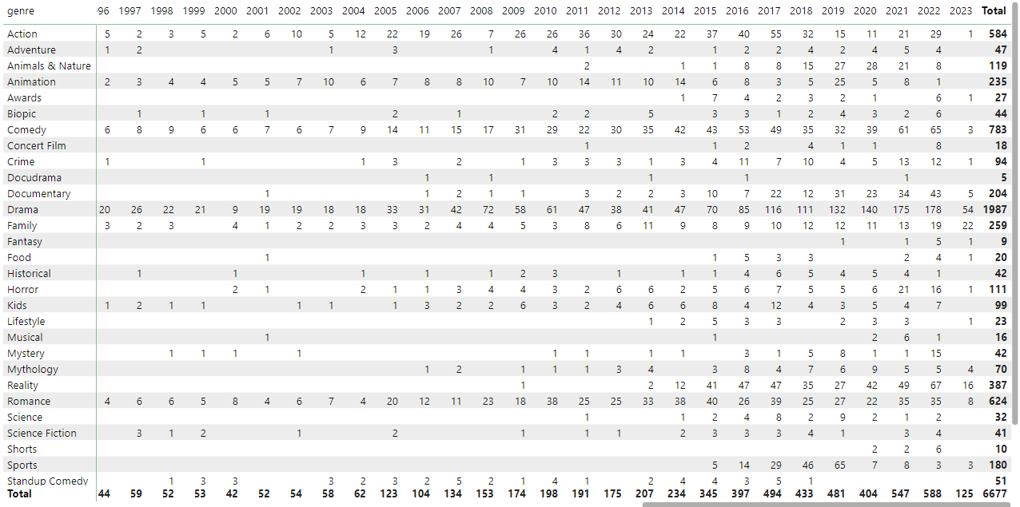
Movie by year & Genre
Summary:
These tables depict the number of movies released each year under each genre

Slide 8
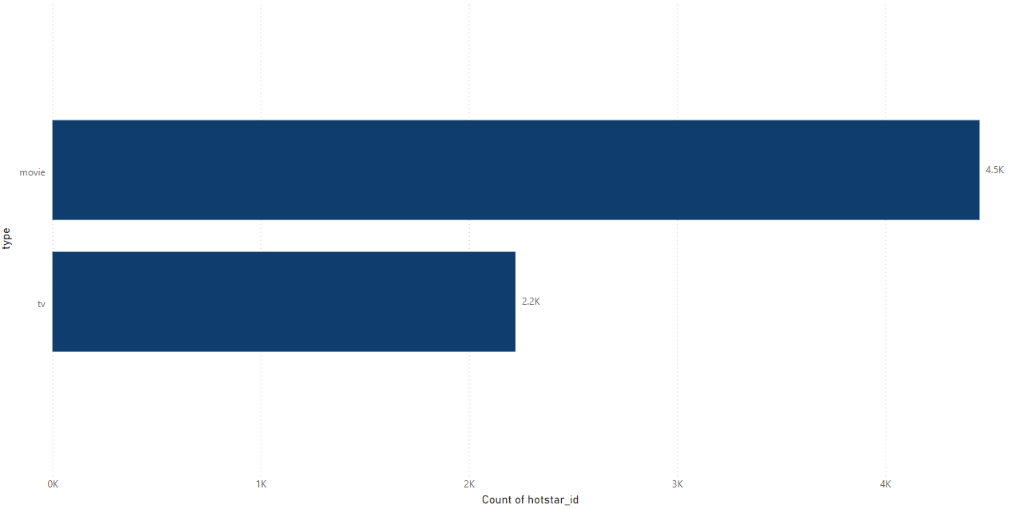
Movie Type
Summary:
4.5K titles on Hotstar are movies
2.2K titles are TV shows

Slide 9
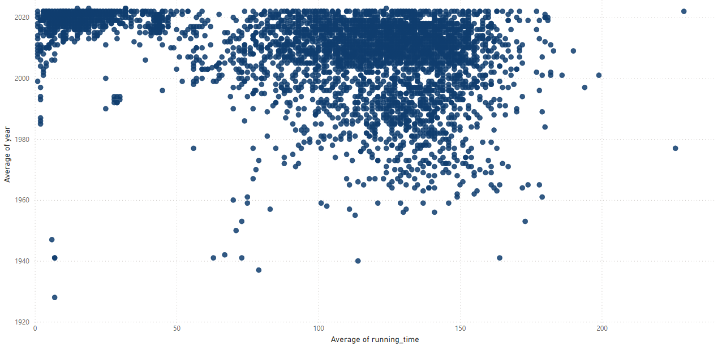
Avg Runtime vs Year
Summary:
Scatter plot depicts the avg runtime over years
229 mins was the avg highest runtime in the year 2022
7 mins was the lowest runtime overall across years

Slide 10
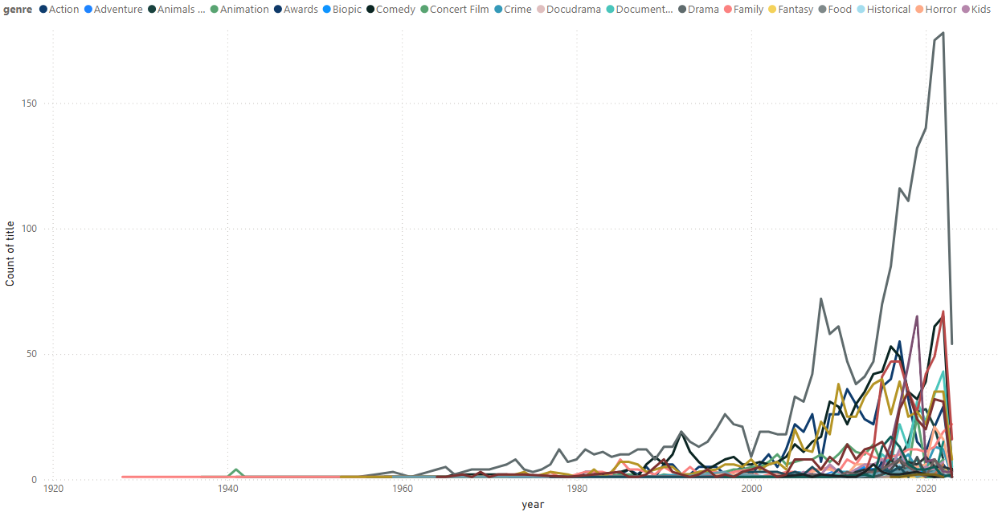
Genre vs Time
Summary:
Year 2022 had the highest diverse genre of movies
Year 1928 had one family genre movie released

Slide 11
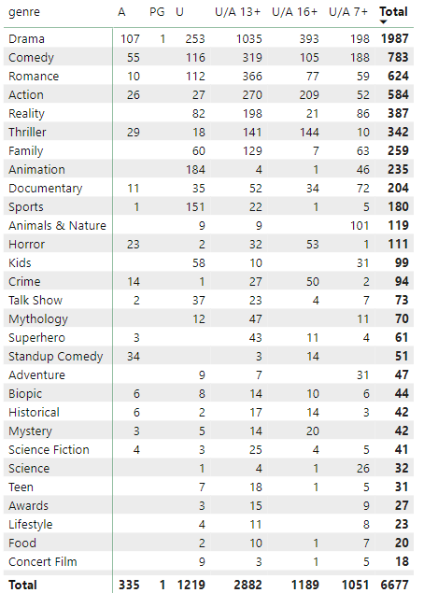
Genre vs Age Rating
Summary:
Drama is the only genre that has movies from all ratings
U/A 13+ has the highest number of movies

Slide 12
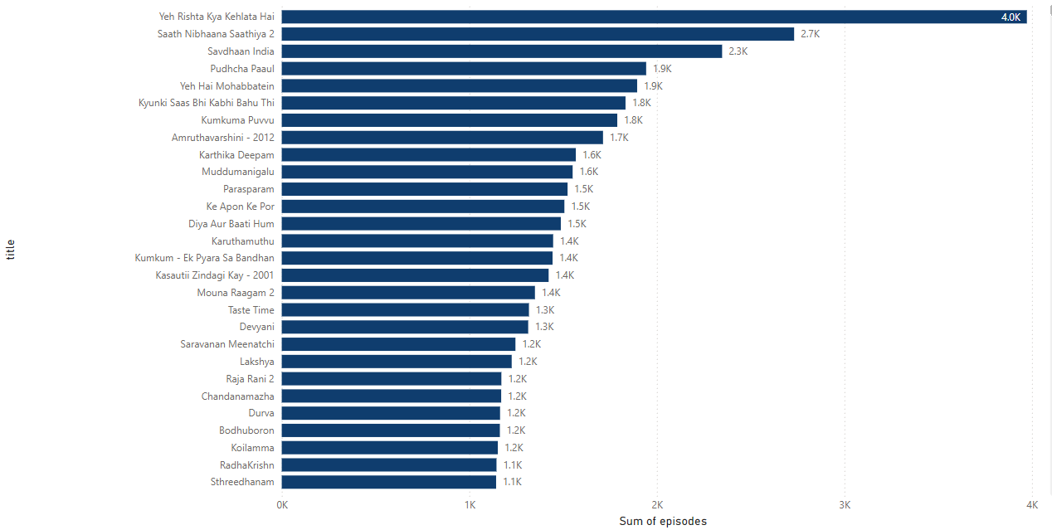
Episodes by title
Summary:
Yeh Rishta Kya Kehlata Hai has the highest number of episodes

Slide 13
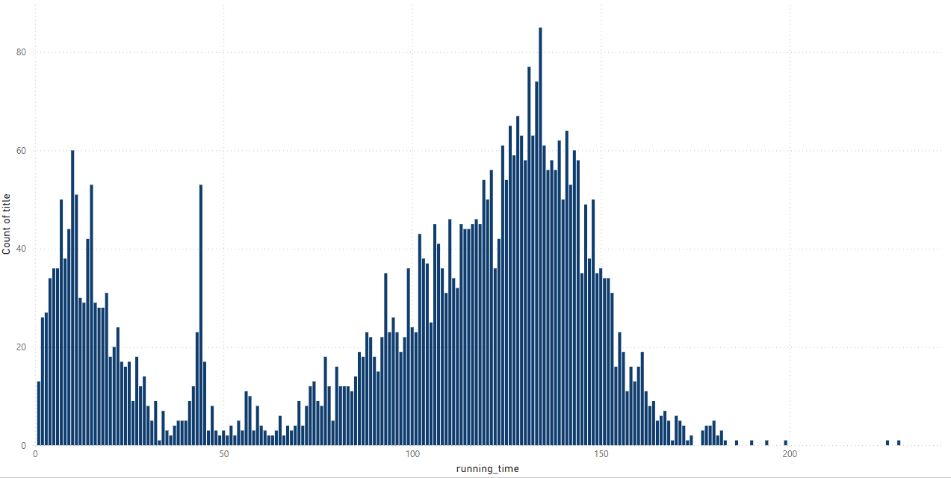
Runtime of movies
Summary:
84 titles have a runtime of 134 mins

Slide 14
Thank you

